Slide 1




Neurodivergence in addiction treatment Services
Designing for Safety, Inclusion and Belonging
Dr Raffaella M. Milani
Dr Luisa Perrino
Kamila Ujkaj

Slide 2
Acknowledgments
Research Team & Collaborators
Dr Raffaella M. Milani – Senior Lecturer, University of East London, Trustee of Addiction Professionals
Dr Luisa Perrino – Senior Lecturer, University of Roehampton
Kamila Ujkaj – Research Assistant, University of East London
Adrian Roche – Project Coordinator, Cranstoun Drug & Alcohol
Lindi Cox-Smith – Sutton Borough Manager, Cranstoun Drug & Alcohol
Simon Green - Windsor and Maidenhead
Service partners & Participants
We would like to sincerely thank all clients and staff who generously shared their time and experiences with us.
Service Partners – Cranstoun Drug & Alcohol Services of
Sutton
Windsor & Maidenhead
Funding
This project was generously supported by the Sir Halley Stewart Trust.
Special thanks to:
Dr Georgia Lockwood-Estrin (UEL)
Dr Florentina Sterkaj (UEL)
UEL and Roehampton BSc Psychology - Anna Pfiko (UEL) and MSc Psychology student volunteers Diana Gomez and Samantha Makepeace

Slide 3
Study background
ADHD Is highly prevalent in substance use treatment populations.
Meta-analyses show 20-25% of people in treatment for alcohol and drug dependence meet criteria for ADHD(Kronenburg, et al., 2023);
This is 3-5 times higher than prevalence in the general population (van Emmerik-van Oortmerssen et al., 2012; Rohner et al., 2023);
ADHD is associated with poorer treatment outcomes (van Emmerik‑van Oortmerssen
et l., 2023 relapses, retention, comorbidity).
Research on Autism Spectrum Disorder (ASD) and substance use is growing, but most studies focus on adolescents or community samples. Evidence within adult addiction treatment services remains limited
(Arnevik & Helverschou, 2016; Weir et al., 2021; Munday et al., 2025).

Slide 4


Rationale – THE INVISIBILITY GAP
Overall Aim: To improve equity, effectiveness, and person-centred care in substance use treatment.
Research in Drug Treatment services in the UK is limited;
Usually focuses on ADHD only, yet in diagnostic services ASD is suggested to have a relationship with process and chemical addiction (Kourti, & MacLeod, 2022);
Service users’ voice requires more representation (Long & Hern 2023);
Neurodevelopmental needs often remain unidentified (Collizi, et a., 2023);
When neurodivergence is not identified or understood, individuals’ expressions of distress are frequently misclassified as psychopathology, a process that can erode their sense of belonging and safety within services and communities (Botha, 2023).

Slide 5
Examples of related neurocircuitry related to substance use
Attention Deficit Hyperactivity Disorder ADHD
Condition that affects behaviour; characterised by difficulty in attention, problems with impulsivity and risk taking, executive functioning difficulties, restlessness, sleep problems and disruption, depression and anxiety conditions (WHO, 2023).
Autism Spectrum Disorder ASD
Diverse group of conditions related to development of the brain; Characterised by degrees of social communication and interaction issues, not understanding emotions or delayed understanding, repetitive and restrictive behaviour, over- or under-sensitivity to light, sound, taste, touch or smell. Symptoms can vary and combine at varying degree with one extreme of the spectrum demonstrating severe disability (WHO, 2023)

Slide 6
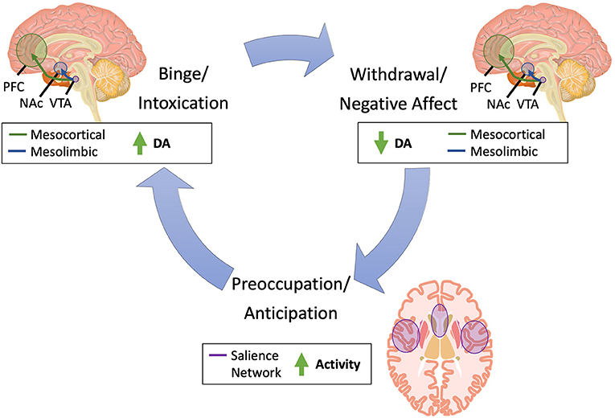
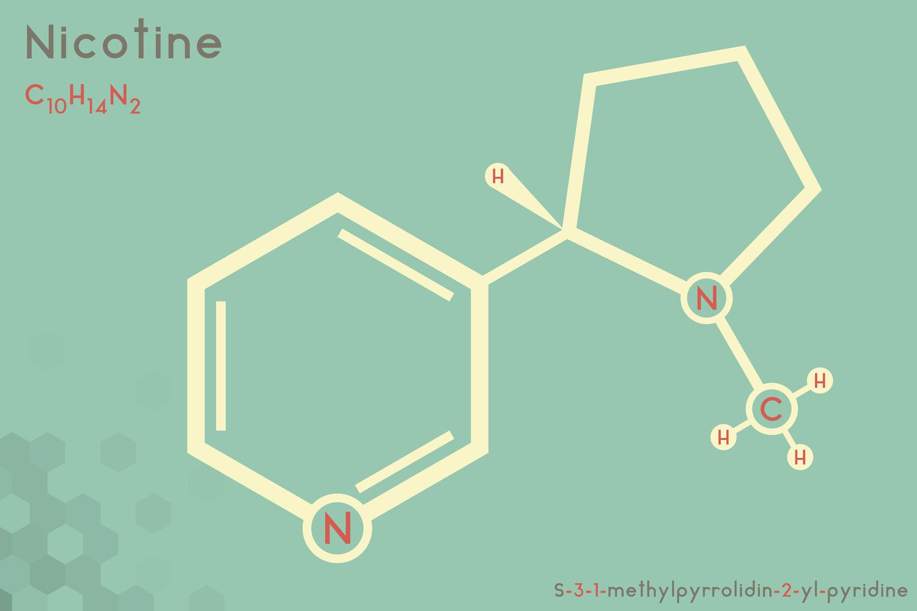

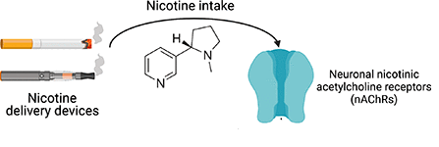
Examples of related neurocircuitry reAttention Deficit Hyperactivity Disorder (ADHD):
RElated to substance use
Groenman, et al., (2013) in a four year follow up study reported higher likelihood of nicotine dependence in those with ADHD (2.4 x higher) versus those without (1.5 x higher).
Adults with ADHD report improved executive functioning with nicotine dependence, and this is consistent with research suggesting the use of nicotine receptor agonists as a treatment for ADHD targeting the neuronal nicotinic acetylcholine receptors (nAChRs; Wilens et al., 2007). Implications for the self-medication hypothesis?
Have Higher Levels of β_{2 nAChRs}
(Stayley et al., 2006)

Slide 7
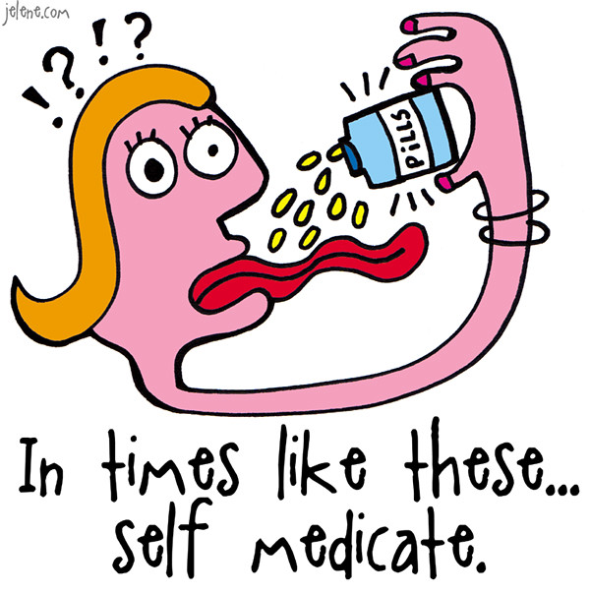
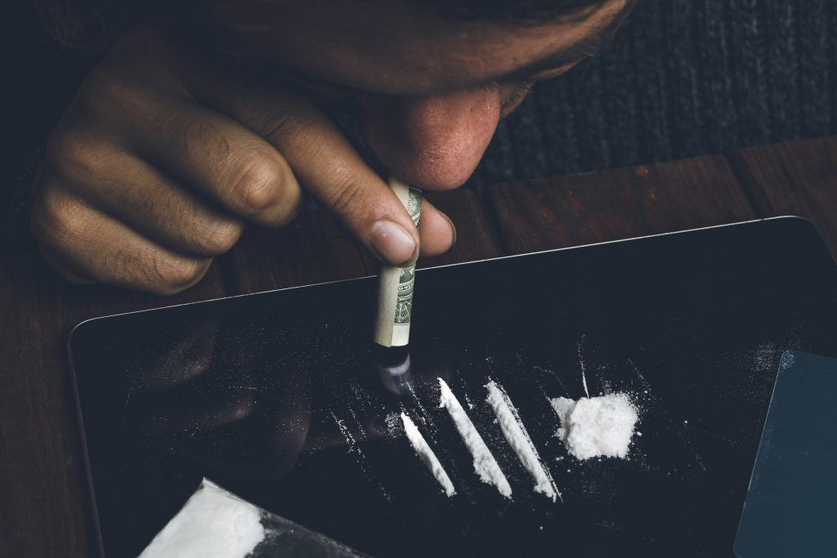

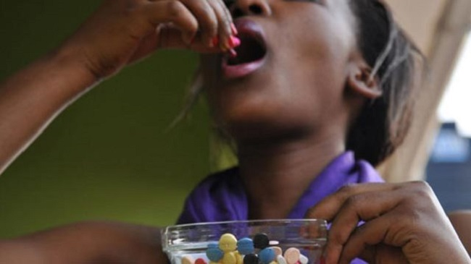
Individuals with Autism more likely to use recreational drugs to self-medicate (weir, et al., 2021)
Weir et al., (2021) studied n= 1, 183 adults with ASD and n=1, 203 non-ASD (16 -90 years old).
Higher levels of drugs used in ASD versus non-ASD counterparts suggested to mask ASD symptoms:
Cannabis use – sleep issues, anxiety, past trauma and sensory overload issues
Cocaine – Heightened attention, euphoria to help manage low mood and depression and, heightened focus
Amphetamines – sense of confidence, euphoria, and heightened focus

Slide 8
objectives
1. Prevalence
Assess ADHD and ASD traits in addiction treatment populations initially across 3 Cranston service sites.
2. Co-existing conditions
Explore trauma, mental health, behavioural addictions, and substance use patterns.
3. Service engagement
Examine treatment pathways and outcomes.
4. Lived experience
Understand how neurodivergent individuals experience health and social care services, including addiction treatment services

Slide 9
Mixed methods action research
Quantitative survey
Qualitative interviews
Analyses
Feedback and discussion:
stakeholder workshop and discussion with Cranstoun’s clinical directors
Recommendations

Slide 10
QUANTITATIVE STUDY – METHODOLOGY
SETTING
RECRUITMENT
CONSENT PROCEDURE
DATA COLLECTION
OPTIONAL PERMISSION
Cranstoun Drug and Alcohol services of Sutton and, Windsor and Maidenhead
Posters and leaflets in service
Key worker signposting to the study
Information sheet + Informed consent (online)
Online survey
Consent for Carepath data access
Consent for Qualitative study

Slide 11
 | Measures
Substance Use Profile | Case notes, substance use questionnaire, the Shorter Promise Questionnaire (SPQ, PROMIS; Christo, et al., 2003)
Alcohol Use | Alcohol Use Disorder Identification Test (AUDIT; Babor, et al., 1992)
Drug Use | Drug Abuse Screen Test (DAST; Skinner, 1982)
Pornography Use | Pornography Addiction Screening Tool (PAST; Zivari-Rahman, et al., 2021)
ADHD traits | Adult Attention Deficit Hyperactivity Disorder Self-Report Scale (ASRS v1.1; Kessler, et al., 2005) Score > 40 - Positive for possible ADHD
ASD traits | Autism Spectrum Quotient (AQ-10; Allison, et al., 2012) AQ-10 score > 6 - Positive for possible ASD
Behavioural Addictions (food consumption, sex, gambling, nicotine and prescribed medication) | The Shorter Promise Questionnaire (SPQ, PROMIS; Christo, et al., 2003)
Depression, Anxiety, Somatization | Brief Symptoms Inventory (BSI, Derogatis and Melisaratos, 1983)

Slide 12
STUDY OVERVIEW & SAMPLE CHARACTERISTICS
Self disclosed Trauma
Demographics & Trauma Responses
<18 yrs
Gender: 60 male, 76 female, 8 missing
Age: Mean 42 (19-79)
Ethnicity: 104 whites, 5 Black, 10 Mixed, 3 Arab, 4 Asian

Slide 13
Prevalence
Comparison between self-disclosed (SD) and ADHD and ASD screening results
What was the prevalence of ADHD and ASD traits

Slide 14
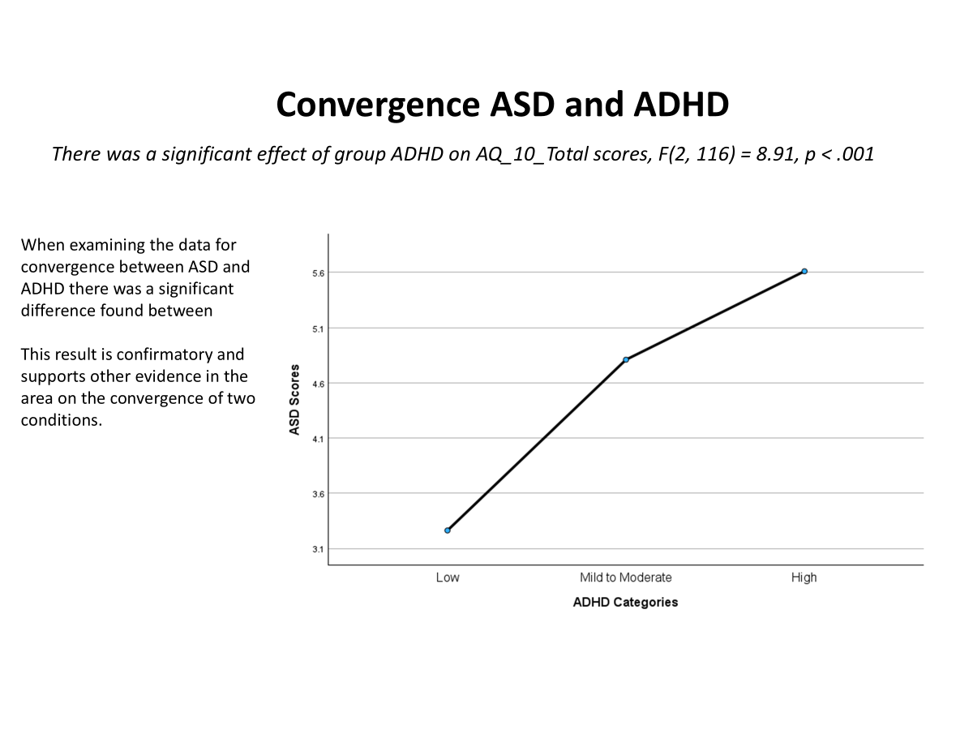
ADHD and ASD convergence

Slide 15
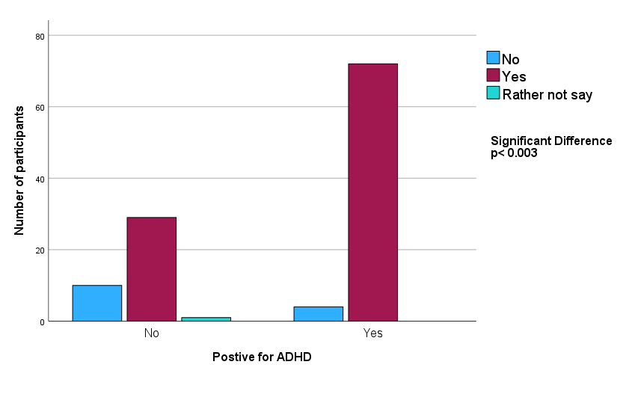
Self-disclosed Adulthood Trauma and ADHD
***

Slide 16
Current use of substances in individuals that screened positive in ADHD and ASD screening

Slide 17
What individuals high in ADHD traits are in treatment for [primary drug]

Slide 18
What individuals high in ASD traits are in treatment for [primary drug]

Slide 19
Behavioural addictions among participants (valid responses, N-129)

Slide 20
What is the relationship between ADHD traits and behavioural addictions within this population?
Behaviour | Correlation (r) | Significance | Interpretation
Gambling | .24 | * | Weaker positive relationship between ADHD symptoms and gambling addiction
Prescribed Medication | .31 | ** | Moderate positive relationship between ADHD symptoms and addiction to prescribed medication
Food | .24 | * | Weaker but still significant link between ADHD symptoms and food addiction scores

Slide 21
What is the relationship between ASD traits and behavioural addictions within this population?
Behaviour | Correlation (r) | Significance | Interpretation
Prescribed Medication | .33 | ** | Moderate positive relationship between ASD symptoms and gaming behaviours
Sex | .20 | * | Higher ASD symptoms associated with increased pornography use

Slide 22
Psychological distress scores by adhd & asd screening status
Participants screening positive for ADHD or ASD showed consistently significantly higher levels of psychological distress across all measures.
Yes: Score were clinically higher (T Score)
🧠 Somatisation
Somatisation is when emotional or psychological distress is expressed through physical symptoms without a medical cause, such as pain, fatigue or dizziness.
🌧️ Depression
Depression is a mental health condition involving a persistent low mood or loss of interest that lasts long enough to interfere with daily life.
⚡ Anxiety
Anxiety is a state of intense worry, fear or unease that can become overwhelming and affect thoughts, feelings, the body and behaviour.

Slide 23
Key conclusions & implications
ADHD traits were highly prevalent in this addiction treatment sample (53%), substantially exceeding estimates reported in the general population.
ASD traits were also present at high levels (37%), highlighting ASD more common in this population than is typically recognised.
Screening identified considerably more neurodivergent traits than self-disclosed diagnoses, suggesting under-recognition in services.
Implications of Trauma!?

Slide 24
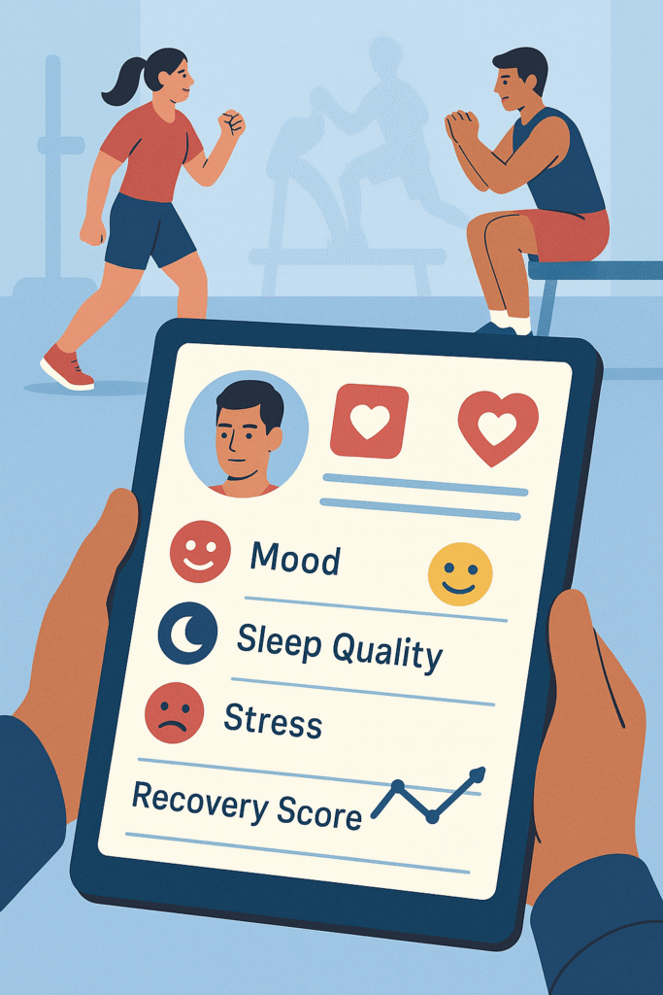
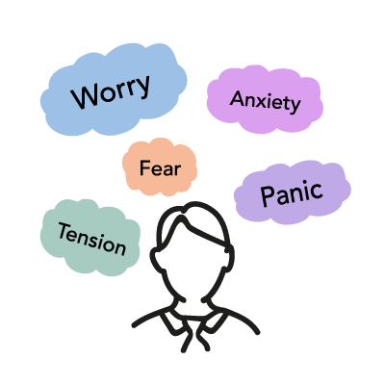
Mental Health & Risk Profile
Individuals screening positive for ADHD or ASD showed consistently higher psychological distress (anxiety & depression).
More likely to struggle emotionally implications for assessment, support planning and treatment engagement.
ADHD screening was also associated with higher somatisation scores. Higher body stress, pain, fatigue, gastro-intestinal discomfort.
Behavioural addictions (particularly nicotine, sex, gambling, and food addiction) were common in the sample.
Notes:
Implications for assessment
Screen routinely for anxiety and depression alongside ADHD/ASD.
Use neurodiversity‑affirming, low‑stress assessment methods.
Distinguish distress linked to neurodivergence from primary mood disorders.
Implications for treatment
Adapt treatment pace, structure, and communication style.
Address emotional regulation early to improve retention.
Offer alternatives to standard group formats when anxiety is high.
Implications for support
Provide predictable routines and clear communication.
Strengthen ongoing emotional and practical support.
Build peer and lived‑experience networks to reduce isolation.

Slide 25

Qualitative
Part

Slide 26
Qualitative Analyses process
22 Interviews
20 clients, 2 staff members
Transcription
Independent Coding
By 6 researchers
Cross-Checking
Shared Codebook
Team Discussion
Final Themes
Thematic Analyses

Slide 27
Substance use as self-medication
“...like my brain slows down... I can do things for longer periods of time... I'm not thinking of 100 things 100 mile an hour.” (P21)
“...It was like, helping me with my anxiety, helping me with my scatty brain, like, helping me, you know. learn all these things.” (P02)
Substance use often reflected attempts to regulate neurodivergent distress rather than risk-taking behaviour.
Addiction as regulation not moral failure.
Neurodivergence (ADHD & Autism)
Emotional overwhelm
Impulsivity
Sensory overload
Social anxiety

Slide 28
Pathways into substance use for individuals with neurodivergence
Participants often described substance use as emerging at the intersection of trauma, late recognition of neurodivergence, and ongoing emotional or sensory distress.
“Sometimes it feels frustrating…these things could have been addressed when I was a child” (P18)
“…the inner child of me is just sitting there, neglected for years.” (P04)
Childhood Trauma / Bulling / Abuse
Late recognition of Neurodivergence (ADHD / ASD)
Emotional & sensory Distress
> Anxiety
> Overwhelm
> Social difficulties
Substance Use as Coping
(“My brain slowed down”)

Slide 29
Barriers to accessing care healthcare
Structural & Experiential Barriers
Barriers
Long waits
Misdiagnosis
Facilitators
Quick contact
Feeling listened to
Stigma
Confusing pathways
ND-aware support
Flexible care
“…like coming here once a week in for an hour that’s difficult, and if you do have any neurodiversity, your head’s crazy.”
“…she asked me why I can’t be homeless…then laughed.”
“…sometimes people think that I’m doing something because I want to get something out of it.”
Structural and relational barriers delayed support and undermined recovery, leading to more dropouts.

Slide 30
Crisis-driven entry to services
Participants often accessed support only after significant deterioration – after harm had escalated.
Distress
Escalation
Crisis
Service entry
“I was just in a place.. I hit bottom so any information that was given to me, none of it sunk in anyway.”
“…then I relapsed and that’s when I tired to stop…get shakes in the hands…my mum and dad said you have to go to the GP… I was drinking in the morning, I wasn’t eating.”

Slide 31
Psychological safety in treatment
Psychological safety was central to engagement and recovery. Participants described Cranstoun as safe, supportive, non-judgmental and understanding.
Feeling listened to
Confidentiality & Psychological Safety
Non-Judgmental staff
Trust in services
Engagement in recovery
"...here at the Hub, I love them, they're brilliant. I felt that they were the first people I actually met in general... I was more sad about leaving them when I graduated“
"It's helped me in ways with meeting people so that I can socialise again”
“I sort of felt listened to, I felt heard, which was really important”

Slide 32
What made treatment effective
Flexible and ND-aware treatment pathways improved outcomes. Medication was often described as life-changing – but access was inconsistent, especially for those with ADHD medication.
Experience of using medications
Reduced cravings
Improved emotional regulation
Flexible Support
One-to-one felt safer for some ND participants
Groups were helpful but sometimes overwhelming
Supported recovery
“I needed a prescription. I needed somewhere to get safety..”
“… but I’ve been better since on Naltrexone, I started in September and haven’t drank since.”
“… I’d say I haven’t joined any of the groups because of social anxiety.”

Slide 33
Reframing addiction through neurodivergence
Understanding neurodivergence helped participants reinterpret addiction as coping rather than failure.
Understanding Neurodivergence
Reduced Shame
Self-compassion
Sustained engagement
"... I started learning more about myself than I did when I first started without services and stuff. And I thought, oh, this is making sense. This is clicking.”
“… now Yeah, I definitely I am less pessimistic about the ability to change, less hopeless about the future, yeah.”

Slide 34
Stakeholders workshop and clinical directors discussion
What we did
Neurodivergence and Addiction workshop (January 2026; NHS and Cranstoun)
Participants included clients, clinicians, practitioners, and service managers
Hybrid format with 16 attendees
The purpose was to present emerging findings, gather practitioner and service-user reflections, & identify implications for service development.
Participants highlighted the need for:
Neurodiversity-informed practice
Improved service accessibility
Better continuity of care
Key insight

Slide 35
Learning from the workshop – Clinical Directors
Service priorities identified
Service development ideas
Flexible engagement pathways (more online options)
Routine neurodivergence screening (working alongside Primary Care)
Clearer communication of support options
Accessible service information
Neurodiversity passport for clients
QR-based support information system
Staff training on neurodivergence and trauma
Stakeholder workshop supported translation of research findings into service development.

Slide 36
Study limitations
Sample and Recruitment
Measurement
Findings may not fully represent individuals less engaged into treatment
Cross-sectional study: findings indicate associations rather than causality
Service-level Carepath data varied in completeness across variables
Overlap between Neurodivergence Symptoms with Substance Use and Trauma
Neurodivergence and mental health measured using screening tools rather than diagnostic assessment
Self-report measures may be subject to recall or response bias
Data & Design
Despite these limitations, the mixed-method approach strengthens interpretations of findings.
We did not provide formal diagnosis, the aim was to identify needs and provide recommendations to meet them

Slide 37
conclusions
Neurodivergence is highly prevalent in addiction treatment populations
Neurodivergence often intersects with trauma, depression, anxiety and psychosomatic symptoms
Participants frequently described substance use as a coping strategy for emotional and sensory distress rather than simply risk-taking behaviour.
High prevalence of process addictions
Addiction services are rarely designed with neurodivergent needs in mind
Structural barriers, stigma, and limited flexibility can reduce engagement and delay access to support.
Multimodal communication and emotional literacy
Break tasks and instruction in small chunks, avoid overwhelming, visual aids, written instructions, check lists, take home aids.
Neurodivergent-informed and psychologically safe services for clients and staff
Findings suggest the importance of early recognition, flexible treatment pathways, and inclusive service design that supports belonging and engagement, for both clients and staff.

Slide 38
Next steps
Development of neurodivergent-informed service resources
Exploration of routine neurodivergence screening pathways
Development of Neurodivergence passport
Strengthen referral pathways for formal diagnosis and support
Project with the Sutton Community NHS Mental Health Services
Integration with digital innovation

Slide 39
references
Arnevik, E. A., & Helverschou, S. B. (2016). Autism spectrum disorder and co-occurring substance use disorder – A systematic review. Substance Abuse: Research and Treatment, 10, 69–75. https://doi.org/10.4137/SART.S39921
Kourti, M., & MacLeod, A. (2022). Autistic people and addiction: A systematic review of risk, protective factors, and service implications. Frontiers in Psychiatry, 13, 946704.
Kronenberg, L. M., Slobodin, O., & Levine, S. Z. (2023). Prevalence of attention deficit/hyperactivity disorder among individuals with substance use disorders: A systematic review and meta-analysis. Drug and Alcohol Dependence, 246, 109843.
Long, C. G., & Hearn, J. H. (2023). Neurodiversity, addiction, and the importance of lived experience involvement in service design: A critical review. Drugs: Education, Prevention and Policy, 30(5), 421–433.
Munday, H., Greymond, D., & colleagues. (2025). Autism and substance use: Emerging evidence and implications for addiction services. Addiction Research & Theory. Advance online publication. https://doi.org/10.1089/aut.2024.0213
Rohner, H., Gaspar, N., Philipsen, A., & Schulze, M. (2023). Prevalence of Attention Deficit Hyperactivity Disorder (ADHD) among Substance Use Disorder (SUD) Populations: Meta-analysis. International Journal of Environmental Research and Public Health, 20(2), 1275. https://doi.org/10.3390/ijerph20021275
van Emmerik-van Oortmerssen, K., van de Glind, G., van den Brink, W., Smit, F., Crunelle, C. L., Swets, M., & Schoevers, R. A. (2012). Prevalence of attention-deficit hyperactivity disorder in substance use disorder patients: A meta-analysis and meta-regression analysis. Drug and Alcohol Dependence, 122(1–2), 11–19. https://doi.org/10.1016/j.drugalcdep.2011.12.007
Weir, E., Allison, C., & Baron-Cohen, S. (2021). Understanding the substance use of autistic adolescents and adults: A mixed-methods approach. Journal of Autism and Developmental Disorders, 51

