Slide 1
Medicine choices in opioid substitution treatment: DHSC guidance
Dr Michael Kelleher
National Clinical Advisor
Addictions Professionals Webinar
6th July 25

Slide 2
Background
Guidance on the choice and use of OST medicines was published by NICE in TA114 and CG52 in 2007
In effect this guidance said that methadone and buprenorphine were equal and should be selected on the basis of patient choice and cost
This advice was updated/expanded in the UK clinical guidelines (the Orange Book) in 2017
Since then:
our knowledge base has grown, and so has the availability of different buprenorphine formulations
we have more evidence that engagement with OST is associated with reduced mortality
the arrival of potent illicit synthetic opioids in the UK has reinforced the importance of engaging and retaining greater numbers of opioid dependent people in treatment
OHID therefore agreed to convene an expert clinical group to advise on updated guidance on the choice and use of OST medicines

Slide 3
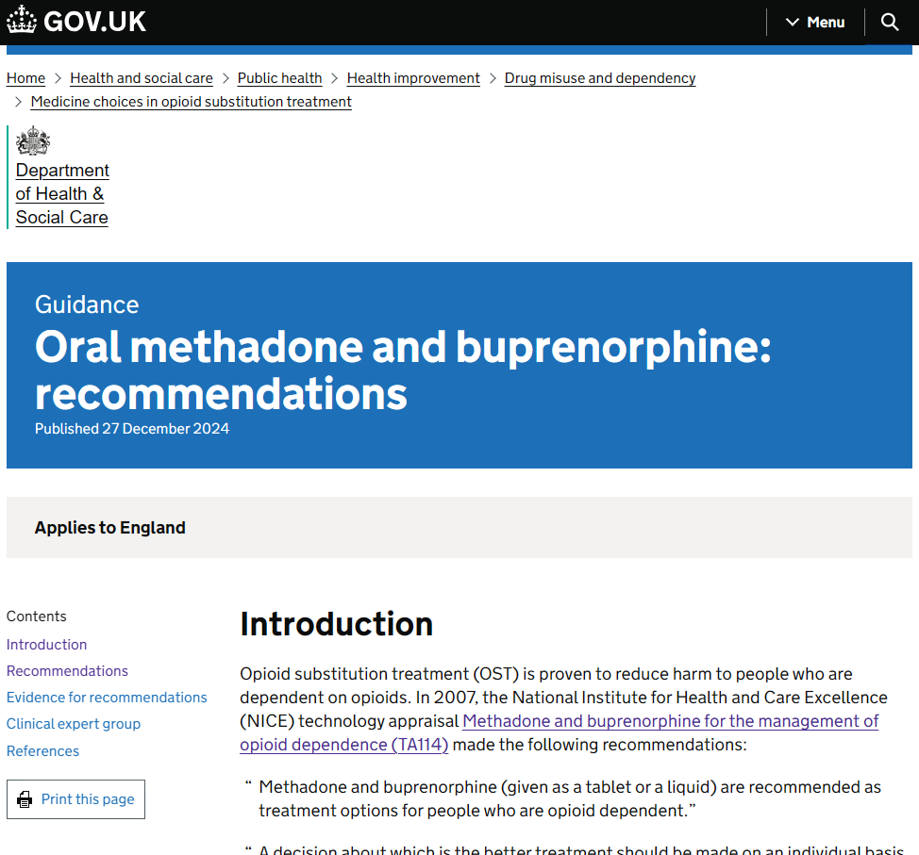
The new guidance
New guidance making recommendations for prescribing methadone and buprenorphine to people in treatment for opioid dependence was published at the end of 2024
It covers the choice between oral methadone and buprenorphine, and their supervised consumption
Further guidance, later this year, will cover buprenorphine long-acting injection
The guidance reiterates, as best practice, much that was already in existing guidance.
Status and remit of the guidance: there is no process agreed for updating the UK-wide clinical guidelines so, although this new guidance seeks to build upon and supplement those guidelines, it is DHSC-published for England only, although other countries have been sent the guidance and may choose to reflect it in their own
NICE is updating its guidance: CG52, to refer and link to this new guidance

Slide 4
Evidence
The guidance’s recommendations are supported by evidence in the following areas:
Difference in fatal overdose risk between methadone and buprenorphine
Differences in pharmacology between methadone and buprenorphine
Risks of non-prescribed use
International experience
The need to increasing the numbers in treatment
Retention in treatment
Therapeutic doses of methadone and buprenorphine
Buprenorphine induction dose and speed
There is more detail on this evidence in the guidance but the slideset focuses on the recommendations.

Slide 5
Recommendation 1: Buprenorphine and methadone must be available
All treatment systems must have buprenorphine and methadone available as treatment options.
In most circumstances, you should offer patients a choice of medication, methadone or buprenorphine.
You should discuss the risks and benefits of each treatment option with the patient.
Where you do not consider one treatment option suitable, you should explain the reason why to the patient.

Slide 6
Recommendation 2: Rapid prescribing should be available
All appropriate patients in every locally-commissioned drug treatment system should have access to rapid prescribing, including on their first day in the service.

Slide 7
Recommendation 3(1): Decisions about supervised consumption should be based on assessment
You should base decisions about supervised consumption of OST medication on an individualised assessment of benefits and risks to the patient and the community. You should do this for each medication and dispensing option. You should also do this assessment in collaboration with the patient.
You should consider balancing the risk of a patient dropping out of treatment and continuing illicit drug use, against the risk to the patient of unsupervised dispensing of medication.
If a patient is prescribed methadone, you should consider keeping the usual requirement for methadone supervision at the start of treatment and ongoing supervision until the patient achieves stability, in line with the Orange Book.

Slide 8
Recommendation 3(2): Decisions about supervised consumption should be based on assessment
If the patient is prescribed buprenorphine, you should consider:
providing take-away doses for the initial dose at the start of treatment, to allow the patient to take buprenorphine when they experience significant withdrawal symptoms and to divide doses where appropriate
unsupervised medication from the start of treatment, subject to an appropriate assessment of the benefits and risks - in appropriate circumstances this can be up to 7 days of oral buprenorphine

Slide 9
Recommendation 4: When to offer buprenorphine before methadone
You should offer buprenorphine in preference to methadone if:
you are concerned that the patient may have a low or uncertain level of opioid tolerance
you are concerned about the patient’s use of other prescribed sedatives and of non-prescribed drug or alcohol consumption (you should advise patients that there is a risk of fatal oversedation regardless of which form of OST medication is prescribed)
the patient has significant comorbid cardiac or respiratory disease
a supervised consumption option does not exist, for example in rural areas
the patient has significant issues with mobility (whether due to physical or psychiatric illness) that prevents them attending a pharmacy regularly
Methadone may still be a viable option in each of these scenarios, after you consider the benefits and risks.

Slide 10
Recommendation 5: In-person assessments for OST
You should usually assess a patient for OST in person. If this is not possible, you can carry out much of the assessment remotely. But you should usually conduct biological testing for non-prescribed substance use, and carry out a physical examination, before a patient starts treatment. For more information, see guidance on Substance misuse: providing remote and in-person interventions.

Slide 11
Recommendation 6: Adequate doses for oral buprenorphine
When inducting a patient onto buprenorphine, you should provide an adequate initial dose.
The Orange Book recommends a dose between 4 and 8 milligrams (mg) on the first day in most cases.
There are clinical scenarios where it may be appropriate to prescribe a lower dose, such as concerns about tolerance, comorbid substance use or lung disease.
There are also scenarios where it may be appropriate to prescribe more than 8mg of buprenorphine on the first day.
Usually, the patient should return the following day for further assessment, and an increase in dose of up to a further 8mg if required.

Slide 12
Recommendation 7: Prescribing the optimal dose
You should prescribe patients the optimal dose of OST medication that supports them to reduce or stop non-prescribed opioid use and remain in treatment.
You should assess patients before each incremental change in dose of OST medication, whether they are prescribed methadone or buprenorphine. You can carry out this assessment remotely if you think it is appropriate, after you consider the risks and benefits.

Slide 13
Recommendation 8: Appropriate monitoring of the patient
For all patients, whether their OST is supervised or unsupervised, they should be appropriately monitored. This includes regular reviews and the opportunity to check the patient’s self-reported history with the results from random drug tests.
At these reviews, you should consider the benefits and risks of the current dispensing regimen, and change it if appropriate.
If the patient shows evidence of not benefitting from unsupervised buprenorphine or methadone dosing, you should consider reintroducing supervised consumption. Or, if appropriate, you could consider switching to long-acting injectable buprenorphine (guidance to follow in 2025).
Evidence for the patient not benefitting can include:
instability
ongoing regular non-prescribed drug use
excessive alcohol use
deterioration of functioning
diversion of prescribed medication

Slide 14
Recommendation 9: Considerations for take-away doses
If you believe the patient is suitable for take-away doses, you should:
assess dangers to children or vulnerable adults in the home from OST medication
provide a lockable box to store the medication, if necessary and unless the patient chooses to provide one
You should also consider whether the patient is at risk of coercion to divert their medication.

Slide 15
Recommendation 10: Safe transfer of prescribing between settings
Services need to ensure that there are smooth arrangements for safe transfer of prescribing between settings, to make sure there is no break in prescribing of OST due to service factors. This includes circumstances such as:
changes to service provision, including opening hours
when the patient moves home
release from prison
admission to and discharge from hospital
In these situations, there should be appropriate communication between settings before a patient is transferred.

Slide 16
Quick references and links
2024 DHSC Medicine choices in opioid substitution treatment
2017 DHSC Drug misuse and dependence: UK guidelines on clinical management (Orange Book)
2007 NICE CG52 Drug misuse in over 16s: opioid detoxification
2007 NICE TA114 Methadone and buprenorphine for the management of opioid dependence
Full references for the guidance, and the evidence used to support the recommendations, are at the end of the online version: https://www.gov.uk/government/publications/medicine-choices-in-opioid-substitution-treatment/oral-methadone-and-buprenorphine-recommendations#references

Slide 17
Credits
Dr Michael Kelleher, clinical adviser to OHID and SLAM (Lambeth) addictions lead, chaired the OST guidance clinical expert group
Members of the expert group for this first-part guidance, to whom OHID and DHSC are grateful, were:
Daniel Ahmed, Cranstoun
Dr Prun Bijral, Change Grow Live
Dr David Bremner, Turning Point
Dr Nicola Kalk, South London and Maudsley NHS Foundation Trust
Professor John Marsden, King’s College London and DHSC
Martin McCusker, Lambeth service user council
Graham Parsons, Waythrough
Soyar Sherkat, Central and North West London NHS Foundation Trust
Professor Sir John Strang, National Addiction Centre
Dr Roya Vaziri, Waythrough
Secretariat was provided, and this slideset prepared, by Steve Taylor at OHID.

